Slide 1


FEBRUARY 2021
Inclusive Investing:
Respecting the Rights of Vulnerable Investors through Supported Decision-Making
Presentation developed by the
CANADIAN CENTRE FOR ELDER LAW

Slide 2

About the Canadian Centre for Elder Law (CCEL)
Legal Research
Law Reform
Legal Education
Outreach
Part of the BC Law Institute, BC’s law reform agency
www.bcli.org/ccel
Notes:
• First, we would like to say something about the Canadian Centre for Elder Law.
• The CCEL is a national, non-partisan agency focused on legal and policy issues related to aging.
The work of the CCEL includes:
- Legal research
- Writing reports to government which make recommendations to improve our laws
- Developing educational tools to help people understand their legal rights and responsibilities under the law
- Community outreach on the law
- Consultation with people in community forms a large part of our work and helps us make recommendations to improve laws.
• To give you an example of what kinds of topics elder law might include:
o Elder abuse and abuse of people with a disability
o Caregiver support
o Age discrimination
o Legal documents that cover financial or health care decision-making.
• This year CCEL celebrates 18 years of work.
• CCEL is part of the BC Law Institute, BC’s law reform agency. BCLI is a not-for-profit organization.

Slide 3
Disclaimer
This presentation is not legal advice.
Notes:
We cannot provide legal advice in this presentation; only legal information.

Slide 4
Presentation Outline:
CCEL Inclusive Investing Project
Disability and decision-making
Law on supported and substitute decision-making for finances
Strategies to support capacity for investment decision-making
Notes:
• Today’s presentation is divided into four parts.
First, we will outline our Inclusive Investing project.
Second, we will talk a bit about disability and decision-making. Specifically, we will focus on dementia and intellectual or developmental disabilities, and how they relate to decision-making ability and capacity
Third we will briefly describe the law on supported and substitute decision-making. The law varies across jurisdictions, so this description is more general. You should consult the laws in your jurisdiction for more information.
As part of the Inclusive Investing Project we are helping the Investment sector to better understand, and respect supported decision making relationships. Our final topic will share some strategies you can use to support your client’s capacity for investment decision-making.
These are only some examples from what we learned in the research and consultation for our project. You may have others that you draw from already.

Slide 5
About the Project
How do people living with a disability use support to make investment decisions?
British Columbia and Ontario (research into law, policy, and practice)
Consultation with 95 key informants:
People living with dementia
People living with an intellectual or developmental disability
Supporters
Investment professionals (advisors, regulators)
Legal professionals and academics (lawyers, notaries, advocates)
Government, Community and Other Sector professionals

Slide 6
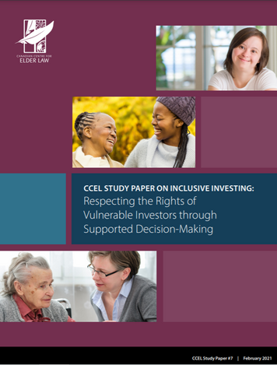
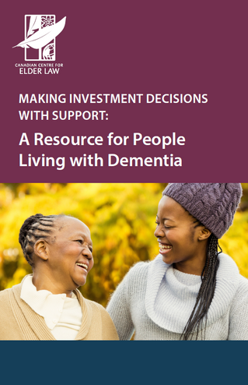
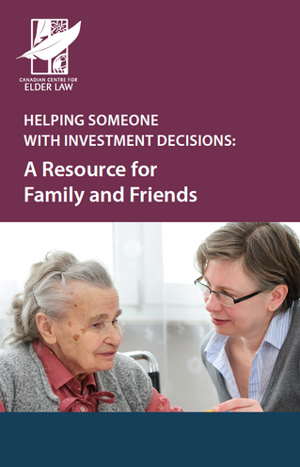

Project Outputs
Study Paper
Booklets
Powerpoint
presentations
All materials available at
http://www.bcli.org/ccel under CCEL Projects

Slide 7
Key Sources of Information for Practice
Your responsibilities may be rooted in:
Laws and Regulations
Institutional Policies
Codes of Ethics
Training

Slide 8

Vulnerable Investors
and the Right to Make Decisions
Fundamental entitlement in a free and democratic society
Some people may be vulnerable to losing their decision-making rights
Vulnerability because of social assumptions, not because of a disability
Notes:
• At law, all adults are presumed capable of making decisions affecting their legal affairs, financial affairs, personal care, and health care.
• Depending on the jurisdiction, if a person is deemed to lack capacity to make financial decisions, and decisions must be made, the law may require that someone be put in place to make decisions for them.
• The term “vulnerable investor” does not describe an investor as vulnerable because of an inherent characteristic.
• Instead, we mean the social vulnerability experienced by people with different abilities. We understand that social conditions, a person’s environment, and assumptions about their abilities (or inabilities) can make a person socially vulnerable regardless of whether they live with a disability. A person’s degree of social vulnerability depends on the real or perceived barriers they experience relative to their interactions with society.
For example, people who live with:
People living with dementia
Survivors of traumatic brain injuries
People with some forms of mental illness
People who identify as living with an intellectual or developmental disability

Slide 9

Investment Needs
of Vulnerable Investors
Investment needs range from conservative to complex:
One or more GICs
Investments within an RDSP
Larger and more sophisticated portfolios
“Capacity" to manage investments can vary
Notes:
• Usually, if someone is perceived as being “incapable” of making decisions, the dominant approach for service providers is to require that they work with a substitute decision-maker
For example, a Power of Attorney or Guardian
Different terms are used in different jurisdictions

Slide 10

Investors living with dementia
What is Dementia? Different types and causes
Not age-specific
Age-associated Memory Loss vs Dementia
Impact on financial or investment decision-making
Notes:
• Dementia is a progressive and degenerative condition, meaning it tends to develop slowly and gradually, worsening over time. Dementia is not age or gender-specific, appearing both in middle aged and older adult populations.
The causes of dementia vary, but the more common ones include:
Alzheimer’s disease;
Vascular dementia (caused by a stroke that affects blood flow to the brain);
Lewy Body disease;
Fronto-temporal dementia;
Parkinson’s disease; and
Mixed dementia (a combination of more than one type).
• It is also common to experience age-associated memory changes as we age. Many people, regardless of their age, experience periods of forgetfulness—misplaced keys, missing ingredients from a quick grocery run at the end of a busy day, laundry left in the washer, failure to return a phone call or text message, and so on.
• Absent any medical diagnosis, these could all be age-associated memory loss
• There are important differences between age-associated forgetfulness and when cognitive or other physical changes are the cause. These changes can lead to challenging situations when, for example, we forget our everyday routine, names of close family and friends, whether we took our medication, whether we ate breakfast, when we forget where we live or where we are going, or when familiar places suddenly seem strange. This type of memory loss may have less to do with age, and more to do with cognitive changes caused by dementia.
• Investors living with dementia may have life-long experience making financial and investment decisions
• A diagnosis of dementia does not mean a person cannot make financial decisions. It is not a simple shift from day to night; ability fluctuates over time. Some changes are subtle while others more pronounced.
• Dementia may cause a decline in memory, judgment, and reasoning skills which could impact a person’s ability to perform one or more of the following financial/investment decision-making tasks:
Difficulty planning or or managing a budget;
Absorb, process, or retain information;
Communicate (verbally or in writing);
Recall recent information or events;
Problem solve;
Difficulty working with numbers;
Focus and pay attention to conversations, tasks or activities. A person might need to take more frequent pauses or may substitute words; or
Recognize family members or familiar places

Slide 11
Memory Loss Due to Alzheimer’s or Dementia
Age-related Memory Loss
Difficulty exercising judgment and decision-making; difficulty solving problems
Making a bad decision occasionally
Difficulty planning or managing a budget; difficulty working with numbers
Missing a monthly payment; making occasional errors when managing finances or household expenses
Difficulty having a conversation; frequent pauses and substitutions when finding words; using words that don’t fit the context
Sometimes forgetting which word to use

Slide 12
Memory Loss Due to Alzheimer’s or Dementia
Age-related Memory Loss
Not recognizing or knowing the names of family members
Sometimes forgetting names or appointments, but remembering them later
Forgetting recently learned information; frequently asking the same question; increasingly relying on memory aids or family members as reminders
Sometimes forgetting the details of information learned
Source: Alzheimer Society of Canada, “Normal aging vs dementia” (24 August 2018):
alzheimer.ca/en/Home/About-dementia/What-is-dementia/Normal-aging-vs-dementia
Notes:
Generally speaking, [t]here is no single definition of intellectual disability.
In Canada, the terms intellectual disability and developmental disability are generally used synonymously, with developmental disability used more frequently.
For instance, in BC and Ontario, the term developmental disability includes people living with Autism, Down’s Syndrome, or other verbal or non-verbal challenges.
Autism is also referred to as a type of intellectual disability.
Consequently, there is some debate over which term should be used.
How a person’s disability is characterized also depends on how they themselves self-identify with it
A person who identifies as living with an intellectual or developmental disability may experience challenges when making financial or investment decisions, such as:
Explaining ideas;
Performing tasks that require multiple steps;
Problem solving;
Learning basic mathematics; or
Understanding or speaking with people they just met.

Slide 13


Impact of dementia on investment decision-making
A person living with dementia, might have difficulty:
Remembering what they have invested;
Filling out paperwork;
Following a conversation;
Communicating their investment needs or goals; or
Understanding what numbers mean.
Their abilities might vary from day to day, or depend on time of day.
A dementia diagnosis can be life-altering. It might also impact their investment priorities.

Slide 14

Investors Living with an Intellectual or Developmental Disability
What does intellectual or developmental disability mean?
Impact on financial or investment decision-making
Notes:
• Generally speaking, [t]here is no single definition of intellectual disability.
• In Canada, the terms intellectual disability and developmental disability are generally used synonymously, with developmental disability used more frequently.
For instance, in BC and Ontario, the term developmental disability includes people living with Autism, Down’s Syndrome, or other verbal or non-verbal challenges.
Autism is also referred to as a type of intellectual disability.
Consequently, there is some debate over which term should be used.
• How a person’s disability is characterized also depends on how they themselves self-identify with it
• A person who identifies as living with an intellectual or developmental disability may experience challenges when making financial or investment decisions, such as:
Explaining ideas;
Performing tasks that require multiple steps;
Problem solving;
Learning basic mathematics; or
Understanding or speaking with people they just met.

Slide 15

Understanding Capacity
• Ability to make your own decisions.
• A person with capacity must show they can:
Understand information;
Apply the information to consider their own situation; and
Appreciate the consequences of a decision.

Slide 16

Capacity is decision specific
Always ask—capacity for what?
What data is relevant?
Different standards apply to different types of decisions
Different ways of communicating decisions
Notes:
• Capacity is decision-specific. A person might be able to make some decisions, but not others, depending on what kinds of information they can understand.
• Capacity is not determined by how a person communicates. People can describe their wishes and preferences verbally, in writing, or with signs or gestures.

Slide 17

Capacity to do what?
Make a will or Power of Attorney
Marry or divorce
Accept surgery or refuse treatment/medication
Mediate or instruct a lawyer
Enter a contract or sell real estate
Participate in research
Donate your money
Appoint a supportive decision maker
Make a decision about a care facility

Slide 18
Factors that Impact Capacity
Decision-making abilities can be impacted by:
• Time of day;
• Meeting environment;
• Medication;
• Lack of sleep;
• Stress or fear;
• Grief or depression; and
• Health issues, such as illness.
Notes:
• For some people, capacity can vary from day to day.
• Other factors are listed in our study paper

Slide 19
(Dis)ability and
Financial Decision-Making
• Every adult is presumed to be capable of their own financial and investment decisions—even if they have a disability.
• Everyone needs different kinds of support with decision-making.
• Many people with disabilities who have an attorney, a representative, or a guardian can make some or all of their own decisions.
• People with dementia or other disabilities may need support to understand the concept of risk.
Notes:
• People living with dementia say that making decisions is “an important means of affirming self-identity and confirmation that “I’m still here”.
• People living with an intellectual or developmental disability say being acknowledged and included in life decisions is critical to fostering independence, respecting autonomy, and building confidence in their ability to live a full life.
• People living with a disability need opportunities to meaningfully engage in decisions that are valuable to them. That might mean relying on support from family or trusted people in their lives (e.g. friends, neighbours, community support workers) to foster participation.
• A desire to make high risk investments does not, by itself, prove a person lacks capacity for investment decision-making.

Slide 20
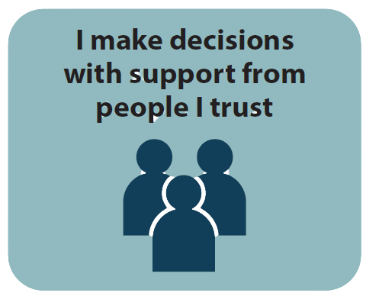
Supported Decision-making
Supported decision-making is when people get the support of friends, family members, and other people they trust to help them understand information and make choices.
• Supported decision-making allows people to make their own decisions.
• Supportive decision-makers “support” a person to
Understand the issues involved in a decision;
Understand the consequences of a decision;
Access appropriate assistance or information to help them make a decision; and
Express their views.
Notes:
• Decision-making can be a very social activity.
• Most people make big decisions with the help of people they trust.
• A supportive decision-maker can help others to:
Truly hear a person who requires support;
Appreciate the person’s needs, rights, values, preferences and goals; and
Respect the person’s autonomy, dignity and wisdom—in other words, help prevent discrimination and bias linked to disability.
• Different jurisdictions may or may not formally recognize supported decision-making in their legislation.
You should review the laws in your province or territory.

Slide 21
Supported Decision-making
Supported decision-making is less familiar
Perceived risk to financial institution
Families may have to choose between not accessing financial institution’s services or going to court to get guardianship order
Yet supported decision-making may be adequate
Notes:
• Sup DM relationships are less familiar to investment professionals and others in the financial sector.
• Based on our previous research into supported decision-making, lawyers and financial sectors may be reluctant to work with supported decision-making relationships because they do not understand the nature of the legal relationship between an adult and a supporter.
They may prefer to work with guardians.
The Sup DM relationship feels risky, partly because with the sup DM framework the person with a disability is responsible for all decisions, not the supporter.
•As a result, adults from different disability communities may risk losing decision making autonomy if they wish to invest their money.
•Sup DM relationships can be adequate to support investor activities.
People may be able to instruct an investment professional with the assistance of a supportive decision-maker.
• Not every Canadian jurisdiction has law that recognizes formal supported decision-making relationships
• But laws that govern both supported and substitute decision-making relationships note the duty of supporters and substitutes to foster the independence of the adult and encourage the adult’s involvement in any decision making that affects them.

Slide 22
Supported Decision-Making Agreements (Canada)
International leader
British Columbia’s Representation Agreement Act
Different models of supported decision-making now exist, to varying degrees, in:
British Columbia
Yukon
Alberta
Saskatchewan
Manitoba
Notes:
• Canada is internationally recognized for leadership in legislated Sup DM.
• Over the past two decades, different approaches to Sup DM have been implemented in some Canadian jurisdictions.
• BC’s Representation Agreement Act created one of the first self-contained Sup DM legal regimes in the world. The law took effect in 2000.
The expression “supported decision-making” is not found in the Representation Agreement Act.
The ability of an adult to appoint a person to “help them” make decisions is set out briefly in section 7
• Some other Canadian jurisdictions have also enacted legislation that recognizes limited forms of Sup DM, using different language and legal frameworks, generally as part of adult guardianship and adult protection legislation.

Slide 23
Supported
Decision-Making in B.C.
Presumption of Capability
Representation Agreement Act
Lower capacity threshold
Assist adult to make decisions, and/or make decisions on behalf of the adult
Section 7—financial decisions—representation agreement
Notes:
• Until the contrary is demonstrated, every adult is presumed to be capable of making decisions about the adult's personal care, health care and financial affairs (Adult Guardianship Act, RSBC 1996, c 6, s 3(1))
• Section 7: Representation agreement with standard provisions. Authorizes an adult to enter into an agreement with a representative in which the representative will “help the adult make decisions, or to make decisions on behalf of the adult” about a range of listed health-care, legal, and financial decisions. This allows a person to choose a Sup decision-maker (representative) by agreement, formalizing the ability of a trusted individual to assist them in making decisions. By virtue of a presumption of capacity inherent in the RAA, BC’s legislation allows the adult and their representative to work together, without the need for court approval, to decide the level and extent of support that will take place. In all circumstances, the support provided by the representative must be done “honestly, in good faith, and with the care, skill, and diligence of a reasonably prudent person.”
• The RAA imposes lower capacity standards than other statutes, which can be met by adults who would not likely meet the capacity requirements to create other personal planning documents, such as powers of attorney. The creation of the RAA owes much to the advocacy of community organizations who sought legal recognition for existing helpers who provide crucial support to adults with disabilities, and an alternative to the existing guardianship regime.

Slide 24
Duties of Supported
Decision-Makers (General)
To keep records
To act honestly
To consult with the person
To consider best interests
Notes:
• The “Duty to Consult” is grounded in law
E.g. Power of Attorney Act, RSBC 1996, s 19(3)(c); same with guardians and committees in BC.
Check your provincial or territorial legislation for comparative obligations
• These duties relate to the obligations of guardians, committees, attorneys, and representatives

Slide 25
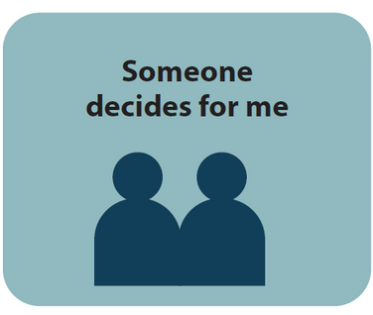
Substitute Decision-Making
If incapable, dominant approach is substitute
decision -making
Example: Guardianship
Substitute decision-makers communicate directly with financial institution staff, physicians, lawyers, and other service providers on behalf of the adult
Duties and powers of the substitute decision-maker are generally clear
Notes:
• A common form of substitute decision making is guardianship, where an individual’s legal right to make all or some of their personal, health care or financial decisions is removed, and a separate person (the guardian) is given the legal authority to make decisions on the adult’s behalf.
• The guardian is sometimes, but not always, a family member.
For example, in BC a family member acting as a financial guardian is called a committee. Guardianship requires an application to the court.
If the Public Guardian and Trustee is the guardian, they may be a property guardian appointed through a process set out in BC’s Adult Guardianship Act, without needing to go to court.
A person might have an attorney through a power of attorney. Or a financial representative, through a standard section 7 representation agreement.
• They also have a right to access personal information.

Slide 26
Substitute Decision-Making
Making decisions for someone else
Last resort
Notes:
• Last resort because decision-making autonomy is a fundamental human right.
• People should be supported to make as much of their decisions themselves before we resort to giving others the power to make decisions for them.
• Respecting rights means the degree and type of support matches a person’s unique needs.
• There are different types of substitute decision-makers for investment.
• Substitute decision-makers have different titles in the various provinces and territories in Canada.
• Depending on where you live, a substitute decision-maker could be a representative, an attorney under a power of attorney, a guardian, or a committee.

Slide 27
Substitute Decision-Making in B.C.
Adult Guardianship Act, RSBC 1996, c 6
Health Care (Consent) & Care Facility (Admission) Act, RSBC 1996, c 181
Patients Property Act, RSBC 1996, c 349
Power of Attorney Act, RSBC 1996, c 370
Public Guardian and Trustee Act, RSBC 1996, c 383
Representation Agreement Act, RSBC 1996, c 405
Notes:
In BC, a substitute decision-maker can be appointed in the following ways:
• By individual (eg. power of attorney, enduring power of attorney, representative for health and personal care decisions)
• By a court
• Authority by statutory process

Slide 28
Substitute Decision-Making Authority
Can cover different types of decisions:
health care
personal care
financial matters
property transfers
facility admission

Slide 29

Supporting Client Capacity
for Investment Decision-Making:
Promising Practices
• Everyone needs different kinds of support with decision-making.
• Get to know your client’s support needs.
• Be curious.

Slide 30

Promising Practices to Support Capacity and Communication Ability
Provide a meeting agenda and list of documents.
Consider font type and size.
Avoid acronyms and clarify confusing terminology or concepts
Speak clearly and allow for pauses. Rephrase questions if needed.
Consider best time of day for your client.
Ask about assistive devices that may foster participation.
Support clients to access the meeting location.
Notes:
• There are many different strategies and promising practices you can use to support capacity for investment decision-making.
• Work with your client and their support people.
• Consider small changes or adaptations that you can make in your practice to foster capacity and participation.
• These are only some examples of promising practices learned about in our research. Consider other options.

Slide 31




Promising Practices to Support Capacity and Communication Ability
• Reduce distractions and background noise.
• Modify the office/meeting space.
• Try different communication strategies to relay
the information (e.g. using visual diagrams or memory cues).
• Speak directly with the client.
• Use scenarios or role play stories to gauge investment knowledge, experience, and risk tolerance.
Notes:
• There are many different strategies and promising practices you can use to support capacity for investment decision-making.
• Work with your client and their support people.
• Consider small changes or adaptations that you can make in your practice to foster capacity and participation.
• These are only some examples of promising practices learned about in our research. Consider other options.

Slide 32



Promising Practices to Support Capacity and Communication Ability
Plan for adequate meeting time. Consider multiple meetings.
Offer food or drinks (for in-person meetings).
Take breaks as needed.
Be a good listener.
Be aware of signs of potential abuse or undue influence.
Notes:
• Good listening involves both physical and mental focus on what the client is saying.
Your body language and eye contact should be directed at the client.
Provide space and time for the client to communicate their understanding of the information, or instructions.
Pause and take notes before responding.
When responding, summarize or reiterate the key points you heard, and ask the client to confirm if your understanding or what you heard is accurate.

Slide 33
Additional Resources
CCEL - Making Investment Decisions with Support
A Resource for Families and Friends
A Resource for People Living With Dementia
Decision Making:
Alzheimer Society of B.C. Making your workplace dementia friendly

Slide 34


Let's stay in touch!
Website: www.bcli/org/ccel
Email address: kjames@bcli.org
Social media:
Questions?
Comments?
@CCElderLaw
@CanCentreforElderLaw

Slide 35



This presentation was developed
by the Canadian Centre for Elder Law as part of
the Inclusive Investing Project.
This project was made possible by a grant from
the Law Foundation of Ontario's Access to Justice Fund and
supported by our project partners:
the Alzheimer Society of British Columbia and Inclusion BC.
For more information, visit www.bcli.org/ccel

